Slide 1

Predictive and Prescriptive Data Analytics for Enhancing Security Decisions in Network Management
Your Name: Mohammad Thaher
Your ID: 21110274
Date: 05/09/2023
Notes:
1

Slide 2
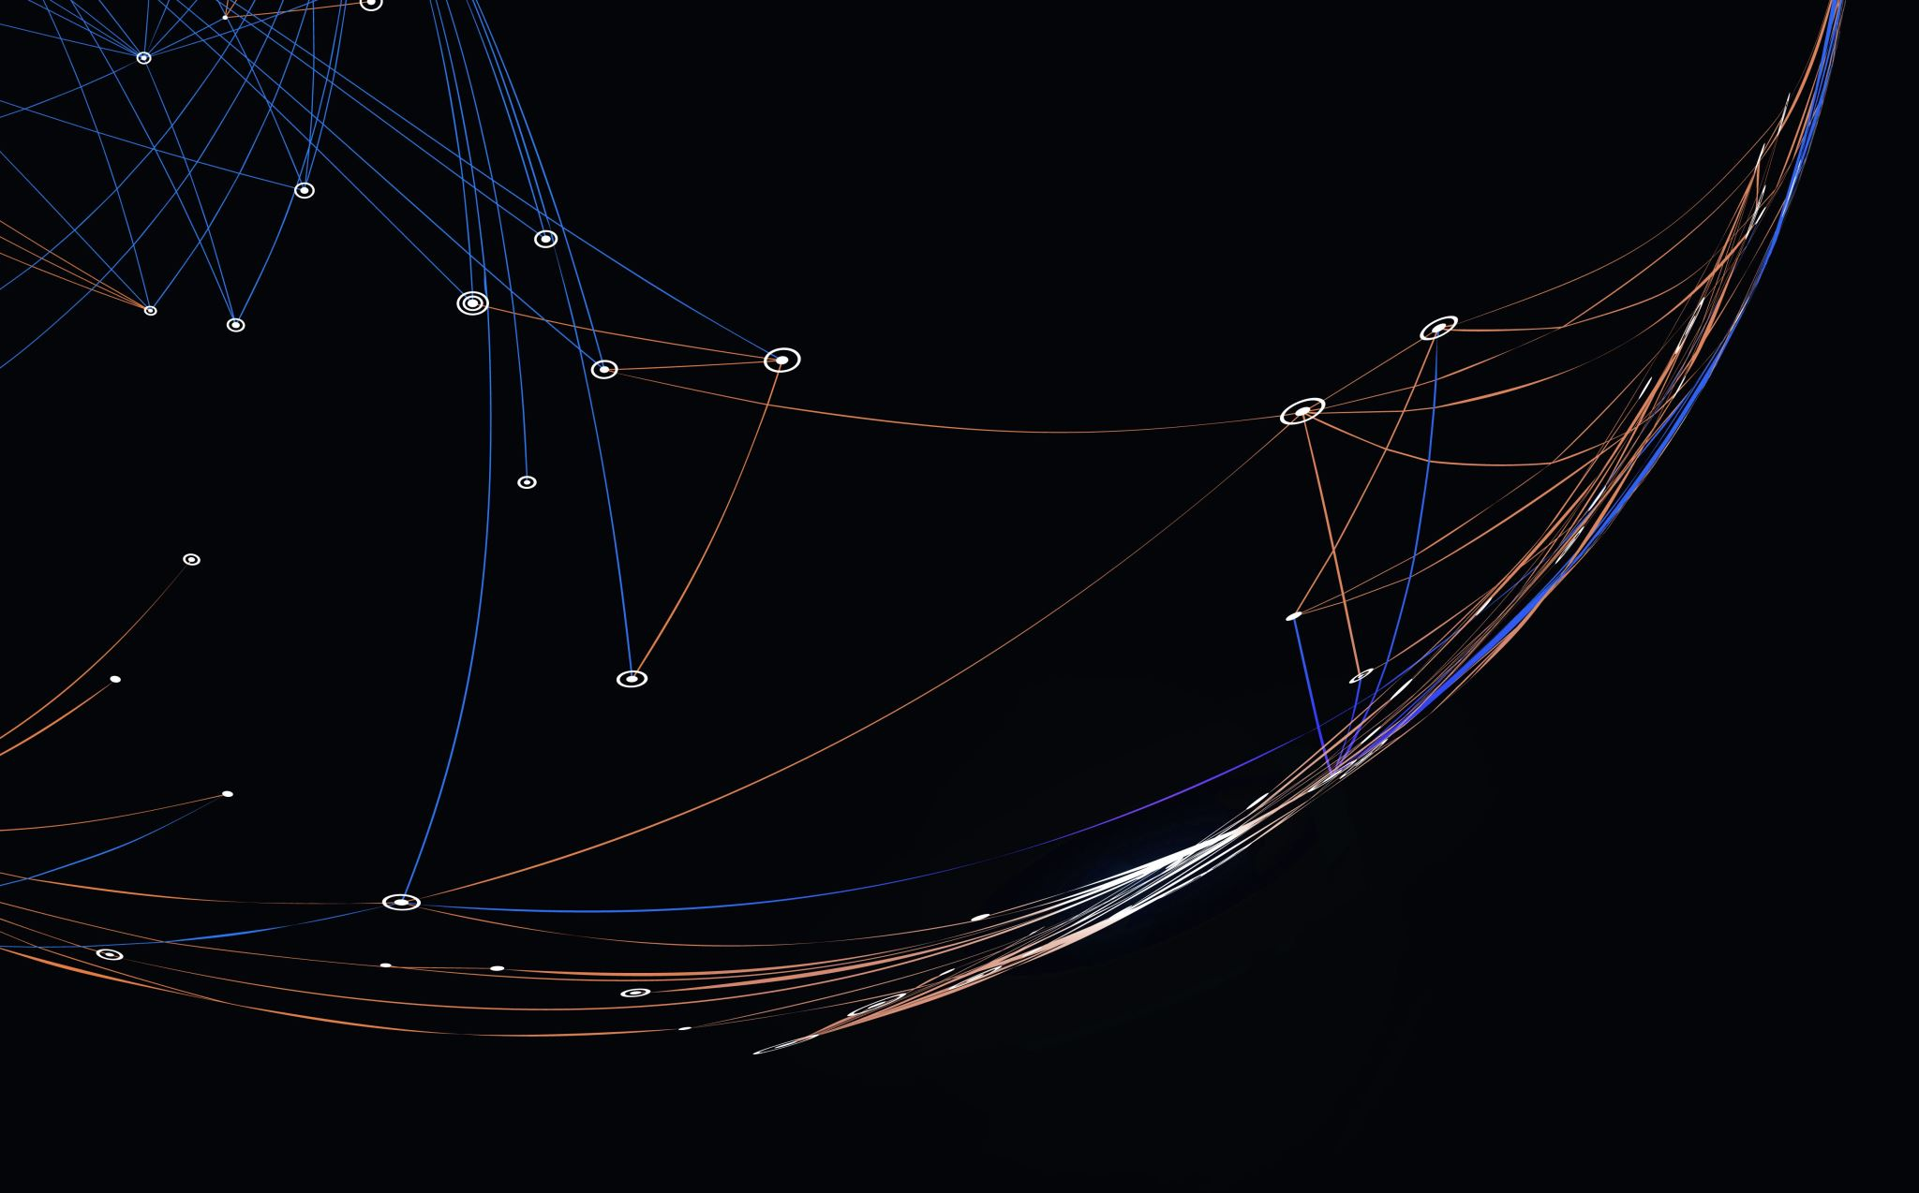
Predictive Analytics

Slide 3


Predictive Techniques Used

Slide 4

Brief overview of the feature selection techniques that used in the project
Recursive feature elimination (RFE):
RFE is a feature selection method that recursively eliminates the weakest feature(s) until the specified number of features is reached. It ranks features based on the model's coefficients or feature importance.
Select K-Best:
This method selects features based on the k highest scores from a defined scoring function. The scoring function used here is f_classif, which is suitable for classification tasks. It ranks features by their importance.

Slide 5
Brief overview of the regression models that used in the project
Linear Regression:Linear regression is a statistical approach for modelling the relationship between a dependent variable and one or more independent variables. It aims to find the best-fitting linear equation that predicts the value of the dependent variable based on the given independent variables.
Decision Tree:A decision tree regression model is a non-parametric algorithm that partitions the data into segments based on selected features. It creates a tree-like structure where each internal node represents a feature, and each leaf node represents a predicted value. The model predicts the target variable by traversing the tree from the root to a leaf node.
Random Forest:Random forest is an ensemble learning method that combines multiple decision trees. It creates a collection of decision trees, where each tree is trained on a randomly selected subset of features and samples. The final prediction is obtained by aggregating the predictions of individual trees, reducing the variance, and improving the overall predictive accuracy.

Slide 6
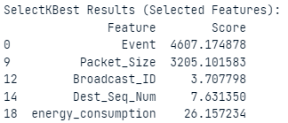
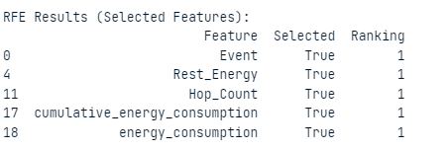
Feature Selection Techniques
FS nov | Name | Results (Selected Features)
1 | SelectKBest
2 | RFE

Slide 7
Compare Regression Techniques
FS Technique | Model | MAE | MSE | RMSE | R2
RFE | Decision Tree | 0.050933 | 0.260565 | 0.493397 | 0.290626
RFE | Linear Regression | 0.163410 | 0.336646 | 0.580212 | 0.024398
RFE | Random Forest | 0.050614 | 0.120770 | 0.347455 | 0.649770
SelectKBest | Decision Tree | 0.054740 | 0.292846 | 0.537567 | 0.151429
SelectKBest | Linear Regression | 0.163332 | 0.336612 | 0.580183 | 0.024495
SelectKBest | Random Forest | 0.051739 | 0.130200 | 0.360775 | 0.623096

Slide 8
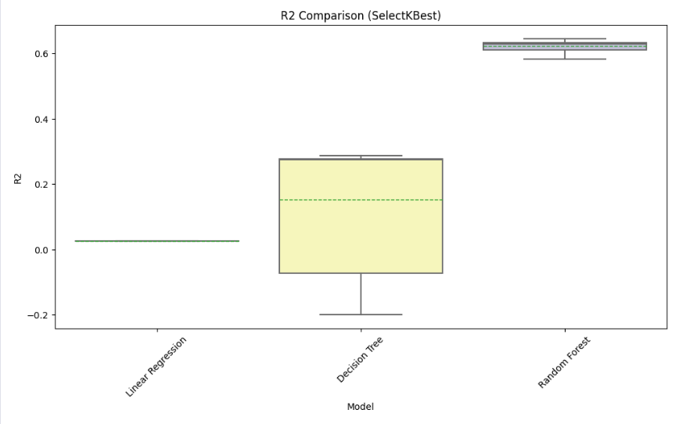
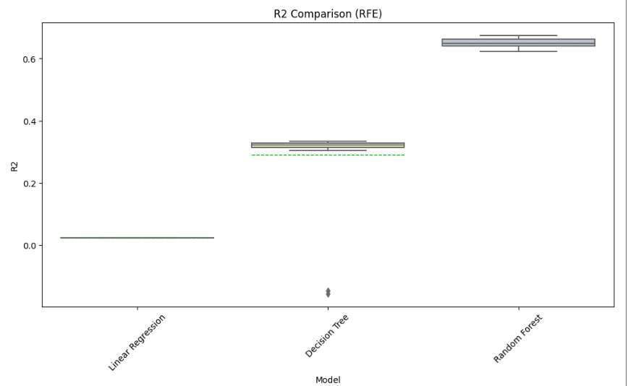
Visualization of results

Slide 9
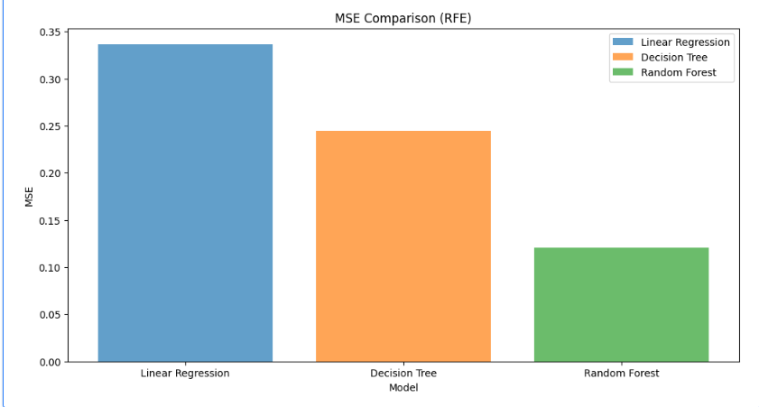
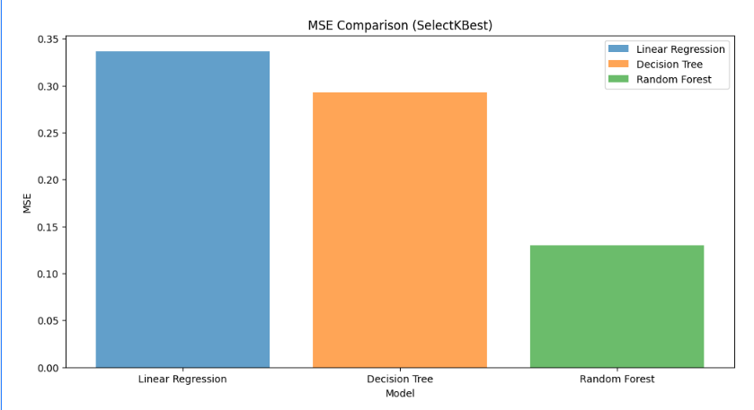

Slide 10

Prescriptive Analytics

Slide 11


Genetic Algorithm (GA)
A genetic algorithm (GA) is a search heuristic inspired by the process of natural selection that optimizes a problem by iteratively improving a population of candidate solutions.
GAs work by simulating the process of natural selection. They start with a population of randomly generated solutions, and then they iteratively improve the population by selecting the best solutions and breeding them to create new solutions. This process is repeated until a solution that meets the desired criteria is found.
GAs are often used to solve optimization problems, such as finding the shortest path between two points or the best allocation of resources. They can also be used to find the best course of action in a given situation. For example, a GA could be used to find the best way to allocate resources in a manufacturing plant or to find the best marketing strategy for a new product.

Slide 12

Game Theory
Game theory is the study of strategic decision-making in competitive situations. It formalizes the interactions between players and analyzes how they can make decisions to maximize their own payoffs.
Game theory models the interactions between players as a game, where each player has a set of possible moves and a set of payoffs for each possible outcome. The goal of each player is to choose a move that maximizes their own payoff. Game theory can be used to find the best course of action in a variety of situations, such as business negotiations, military conflicts, and political elections.
Game theory is a complex and challenging field, but it is a powerful tool for understanding and predicting strategic behavior. It has been used to great effect in a variety of real-world applications. For example, game theory has been used to analyze the strategies of companies in competitive markets, to design optimal military strategies, and to predict the outcome of elections.

Slide 13

Particle Swarm Optimization (PSO)
Particle swarm optimization is another search-based optimization technique that is inspired by the behavior of flocks of birds or schools of fish. In PSO, each solution is represented by a particle. The particles move through the search space, and their movements are influenced by their own best positions as well as the best positions of their neighbors.
PSO works by having each particle start at a random position in the search space. The particles then move through the search space, and their movements are influenced by their own best positions as well as the best positions of their neighbors. The particles are attracted to the best positions they have encountered, and they are also attracted to the best positions that their neighbors have encountered. This process is repeated until a solution that meets the desired criteria is found.
PSO is often used to solve optimization problems, such as finding the minimum of a function or the maximum of a profit function. It can also be used to find the best course of action in a given situation. For example, PSO could be used to find the best route for a delivery truck or to find the best investment strategy for a portfolio.

Slide 14

Objective Function Code

Slide 15
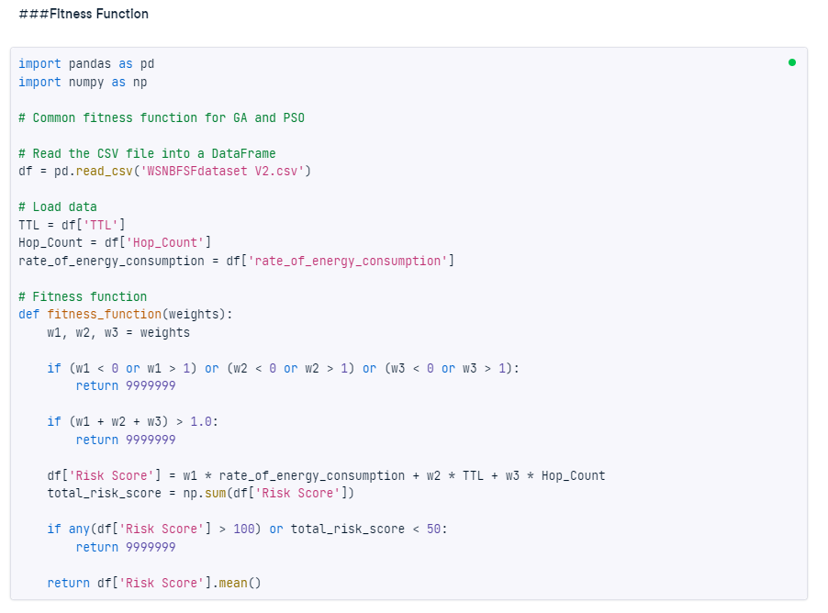
Objective Function Code (Your Work)

Slide 16
Results and Explanation
GA: Best solution is [0.15380151488723437, 0.0029088343478261836, 0.00036319733567979906] with fitness 0.10880279035213597 Found at run 10 and generation 163
PSO: Best solution is [0.6348626766354147, 6.3132291828671046e-09, 5.161914073930072e-07] with fitness 0.16371807544075545 Found at run 4 and iteration 133

Slide 17
Results and Explanation
Genetic Algorithm (GA):
Best Solution: [0.15380151488723437, 0.0029088343478261836, 0.00036319733567979906]
Fitness: 0.10880279035213597
Found at Run 10 and Generation 163
The GA has found a set of weights (W1, W2, W3) that result in a low fitness value of 0.10880279035213597. In many optimization problems, lower fitness values indicate better solutions. These weights are likely used in a risk assessment model to predict whether a node is 'at risk' or not.
Particle Swarm Optimization (PSO):
Best Solution: [0.6348626766354147, 6.3132291828671046e-09, 5.161914073930072e-07]
Fitness: 0.16371807544075545
Found at Run 4 and Iteration 133
Similarly, the PSO algorithm has found a set of weights (W1, W2, W3) that result in a fitness value of 0.16371807544075545. While this fitness value is higher than the GA's fitness value, it's essential to consider the specific problem and the range of fitness values.
Threshold Value for Classification:
Threshold Minimum Risk Score: 0.08281756567259191
The threshold value is used to classify nodes as 'at risk' or not. Nodes with a risk score above this threshold will be classified as 'at risk,' and those below it will be classified as 'not at risk.' In this case, the threshold is set at 0.08281756567259191.

Slide 18
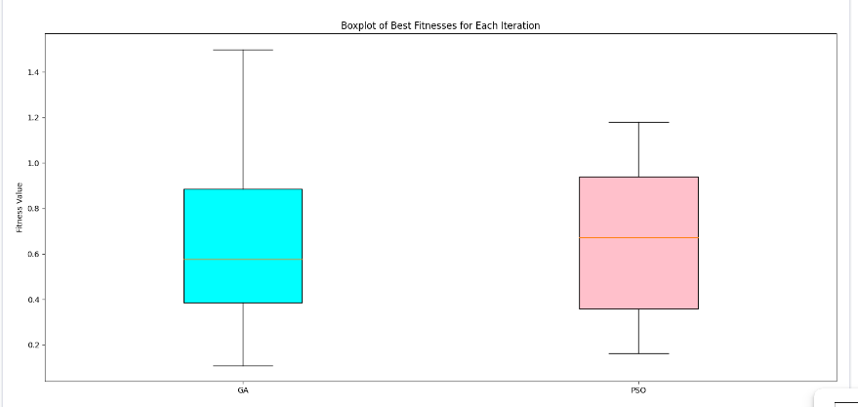
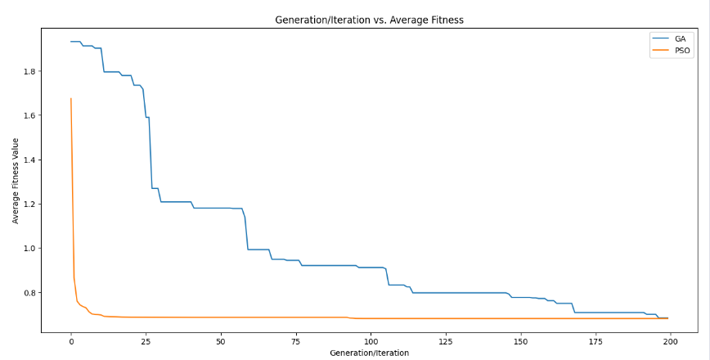
Visualization and Explanation

Slide 19
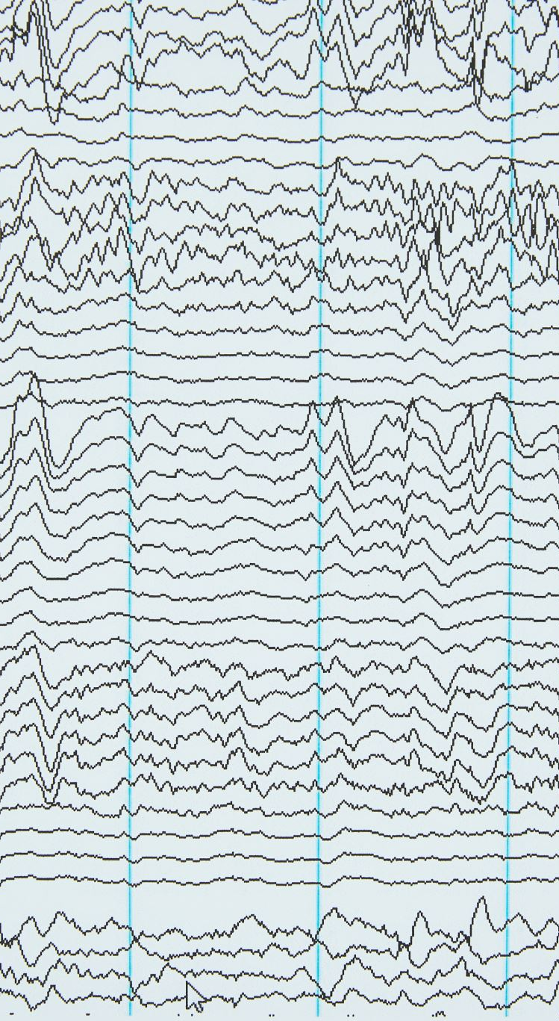
Visualization and Explanation
The photo shows the results of a simulation comparing the performance of two optimization algorithms: genetic algorithm (GA) and particle swarm optimization (PSO). The x-axis of the graph represents the number of generations/iterations, and the y-axis represents the average fitness value.
The boxplots on the left side of the graph show the distribution of the best fitness values for each algorithm at each generation/iteration. The GA boxplots are consistently higher than the PSO boxplots, which indicates that GA is generally more successful in finding high-fitness solutions. The median fitness values for GA are also greater than those for PSO, which further supports this conclusion.
The line graphs on the right side of the graph show the average fitness values for each algorithm over time. The GA line graph is consistently above the PSO line graph, which again suggests that GA is more effective in finding high-fitness solutions. However, the gap between the two lines narrows as the number of generations/iterations increases, which indicates that PSO eventually catches up to GA.
This behavior can be explained by the different ways in which GA and PSO explore the search space. GA is a more cautious approach that integrates and alters solutions over time, allowing for a slower but more thorough exploration. PSO, on the other hand, is a more aggressive optimization technique that rapidly explores the search space due to particles updating based on both personal and neighbor information.
The wider initial gap between the GA and PSO line graphs suggests that GA has a faster initial convergence rate. This is because GA is able to quickly identify promising solutions and focus its search on those areas. However, PSO's more aggressive approach allows it to eventually catch up to GA and even surpass it in terms of fitness.
In conclusion, the combined analysis suggests that GA is generally more effective in finding high-fitness solutions, but PSO exhibits a quicker initial performance and may approach GA's level of effectiveness as iterations progress. The choice between these optimization techniques depends on the specific problem and the trade-off between rapid exploration (PSO) and comprehensive search (GA). It is essential to consider the problem context and conduct further research to validate these findings for specific applications.

Slide 20
References
Goldberg, D. E. (1989). Genetic algorithms in search, optimization, and machine learning. Addison-Wesley.
Kennedy, J., & Eberhart, R. (1995). Particle swarm optimization. IEEE Transactions on Evolutionary Computation, 1(1), 26-34.
Quinlan, J. R. (1986). Induction of decision trees. Machine Learning, 1(1), 81-106.

